Slide 1



The Rust
programing language
Interactive workshop by
Cosmin and Lucas

Slide 2
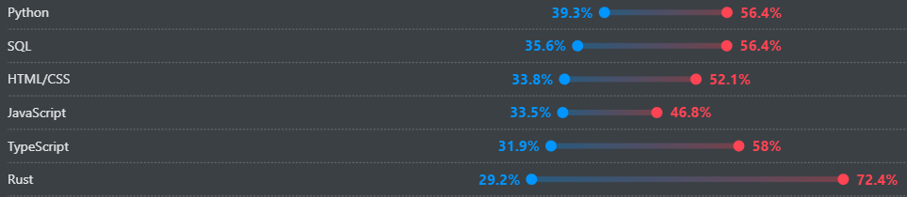

Programing language with an emphasis on:
Safety
Performance
Productivity
Rust most admired programing language 2025
Cargo (rust tool) most popular cloud development tool 2025
Used in:
Windows components
Discord
Linux kernel

Slide 3
Features of rust:
Memory safety without garbage collector
Cargo package manager
Pattern marching
Comprehensive error messages
Safe Concurrency
Zero-cost abstractions
Modern syntax

Slide 4
Programing language | Rust | C++ | Java
Memory safety | High | Low | High
Concurrency safety | High | Low | Low
Performance | High | High | Low
Ease of learning | Low | Medium | High
Ecosystem | Medium | High | High
Use in legacy systems | Low | High | High

Slide 5

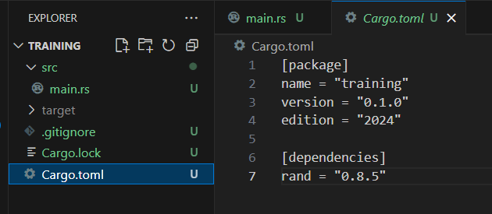
Cargo

Slide 6
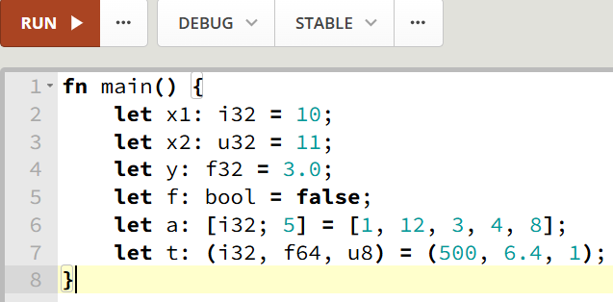
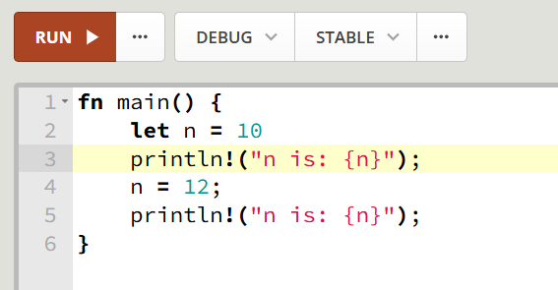
Variables
?

Slide 7
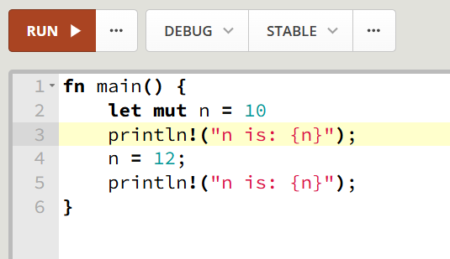
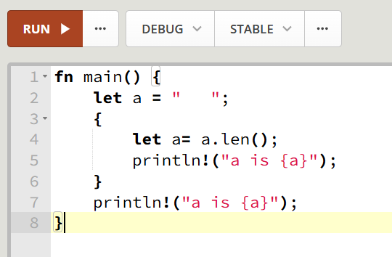
Mutability and Shadowing

Slide 8
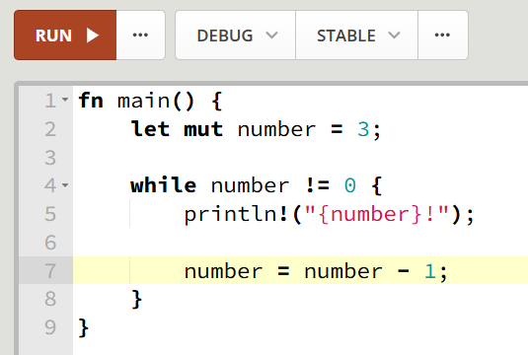
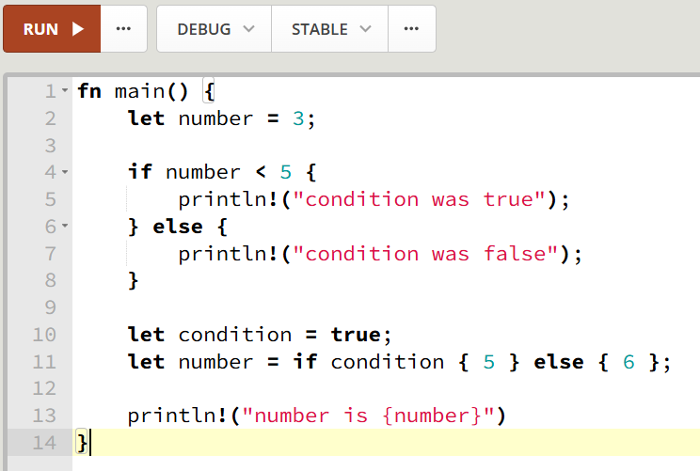
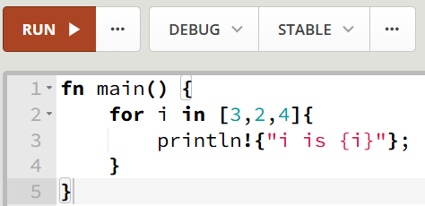
Control flow

Slide 9
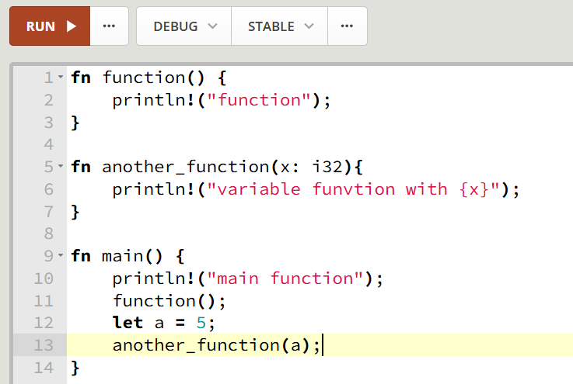
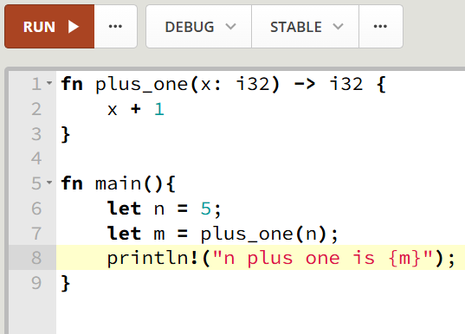
Functions

Slide 10
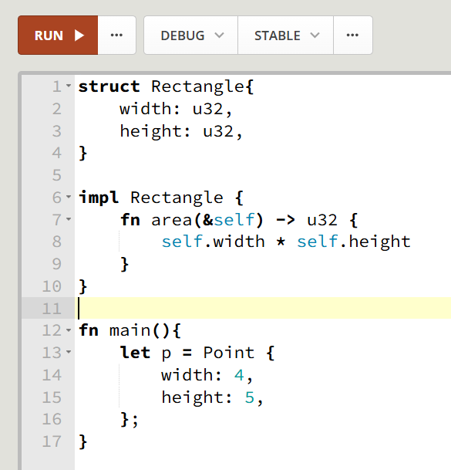
Structs

Slide 11
Borrow checker

Slide 12
Lifetimes

Slide 13
Enums and Match

Slide 14
Error handeling

Slide 15
Concurency 1

Slide 16
Concurency 2

Slide 17
Exercise:
Make your own rust program

Slide 18
QnA

